Slide 1

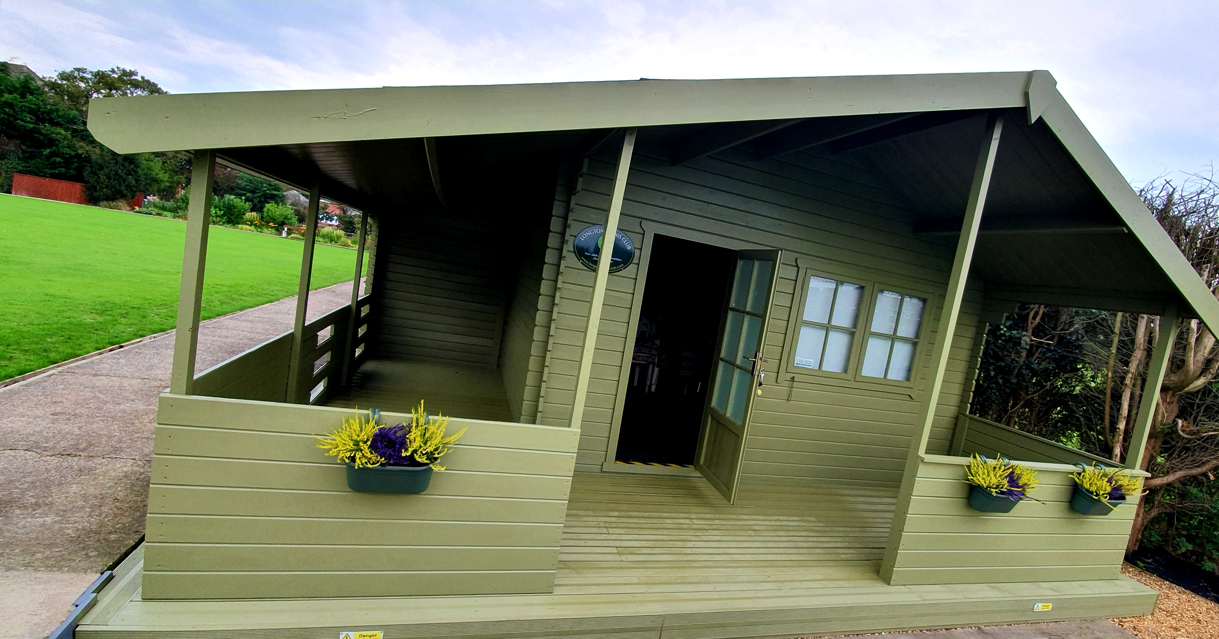
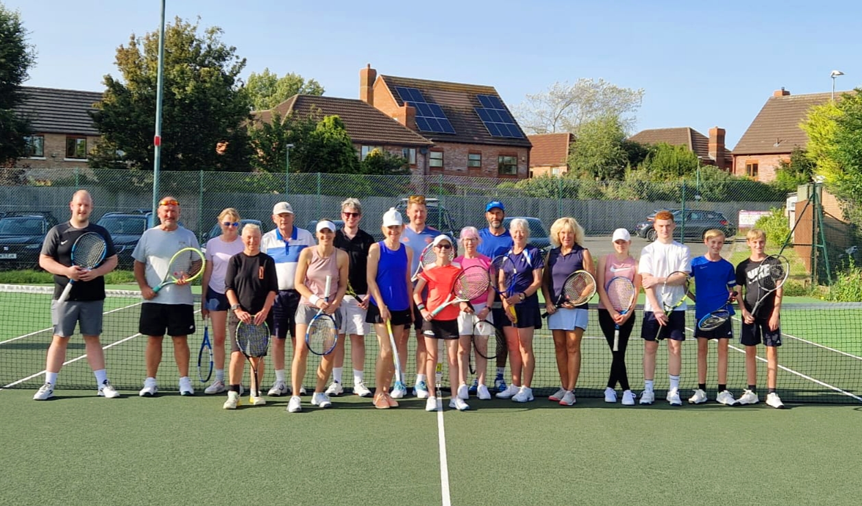


WELCOME TO THE CLUB
SOCIAL & TEAM TENNIS
USING THE COURTS
Join our social tennis on
- Thursdays 6:30pm
- Sundays 2:00pm
- Ladies coffee morning 10am on Thursdays
There is team tennis available in the Ribble and Fylde leagues for adults & juniors
Seasonal Club Tournaments where all members are welcome to play - Spring Smash, Summer Smash, Treacle Toffee and Christmas Jumper.
Look out for messages on our social WhatsApp group!
Please remember to book online or use the mobile app to reserve the court.
The padlock code is 7891
Club members under 13 years of age, must be accompanied by an adult whilst using the courts.
POLICIES AND CLUB RULES
It's important that you familiarise yourself with our club policies. We are a small but mighty club and we want every member to feel safe and welcomed.
If you have any concerns, please contact our welfare officer Allison Moosa at longtontcwelfare@hotmail.com or on 07814127397
For more details, follow us on Instagram and check our website. Safeguarding information online:
https://www.safetoplaytennis.co.uk/
This is a mobile friendly version

